Slide 1
Depreciation and Taxes
APSC 221 – Week 4
Summer 2024

Slide 2
“In this world nothing can be said to be certain,
except death and taxes”
- Benjamin Franklin, 1789

Slide 3
Depreciation
Quantification of asset loss
Use-related physical loss:
Ie, wear and tear on your car
Measured in relation to a function of use or production
Time-related loss:
Ie, rust on your car
Measured in relation to a unit of time
Functional loss:
Ie, smart phones over flip-phones
Measured in relation to a relative loss of function
Driven by legislative change
Notes:
Engineering projects often involve investment in equipment or other physical assets. All physical assets lose value, depreciate, over time.
We also need to understand depreciation for taxes and accounting (and their affect on how we do our engineering analyses)

Slide 4
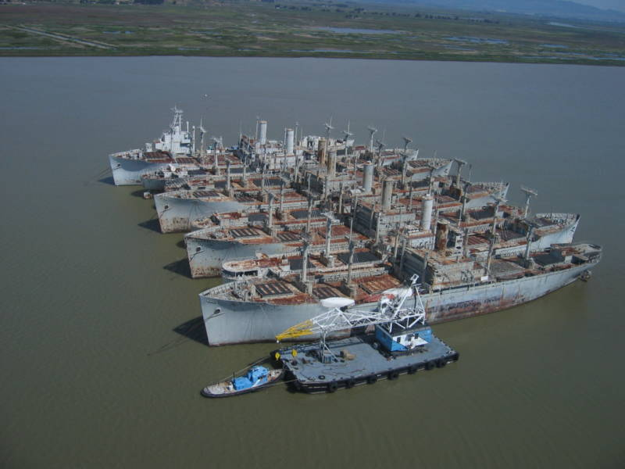
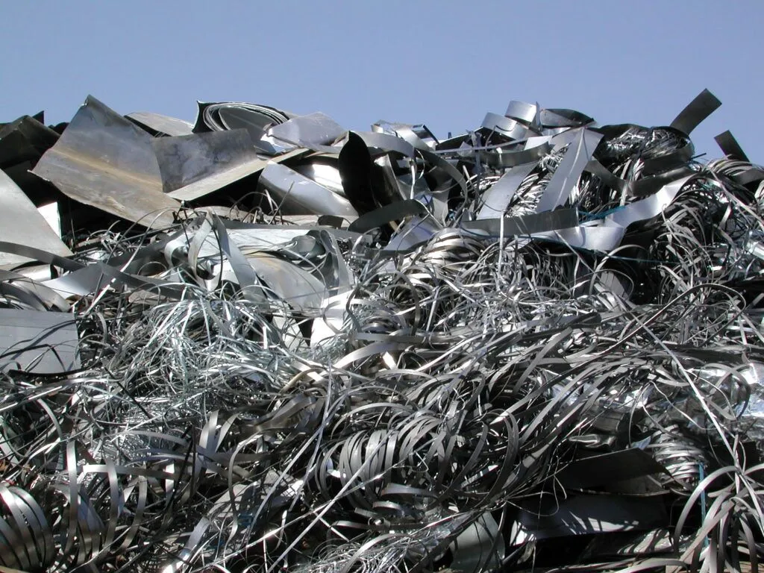
Valuation of Assets
Depreciation models used to estimate the value of an asset at a given point in time.
Definitions
Market Value
Value of an asset on the open market (ie, sale value)
Book Value
Value of an asset for accounting purposes
Salvage Value
Actual or estimated value at the end of its useful life
Scrap Value
Actual or estimated value at the end of its physical life
Notes:
Market value difficult to estimate
Book value can vary from market value and even vary based on the type of book value

Slide 5
Why estimate asset values?
Managerial decision-making:
Knowing asset values support business transactions (ie, loans)
Planning:
Replacement decisions require knowing these values
Tax compliance:
Taxes paid on net income (ie, revenue less expenses)
Regulations on the amount of depreciation that can be expensed

Slide 6
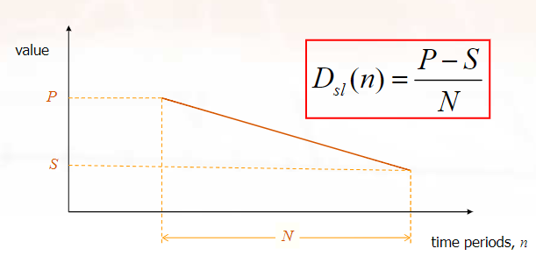
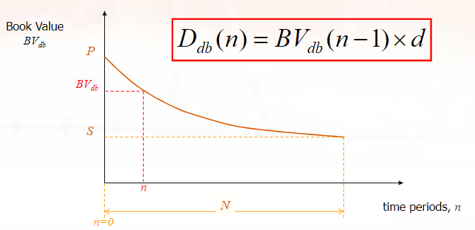
Depreciation Models
Many different models exist, but 2 are primarily used in Canada
Straight Line Depreciation
Declining Balance Depreciation
Notes:
Market value difficult to estimate
Book value can vary from market value and even vary based on the type of book value

Slide 7
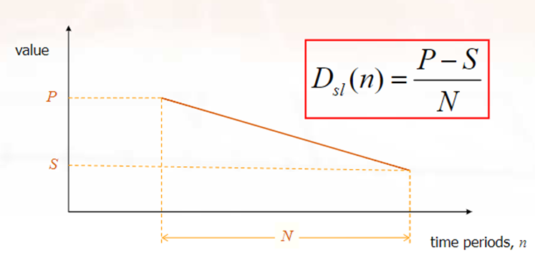
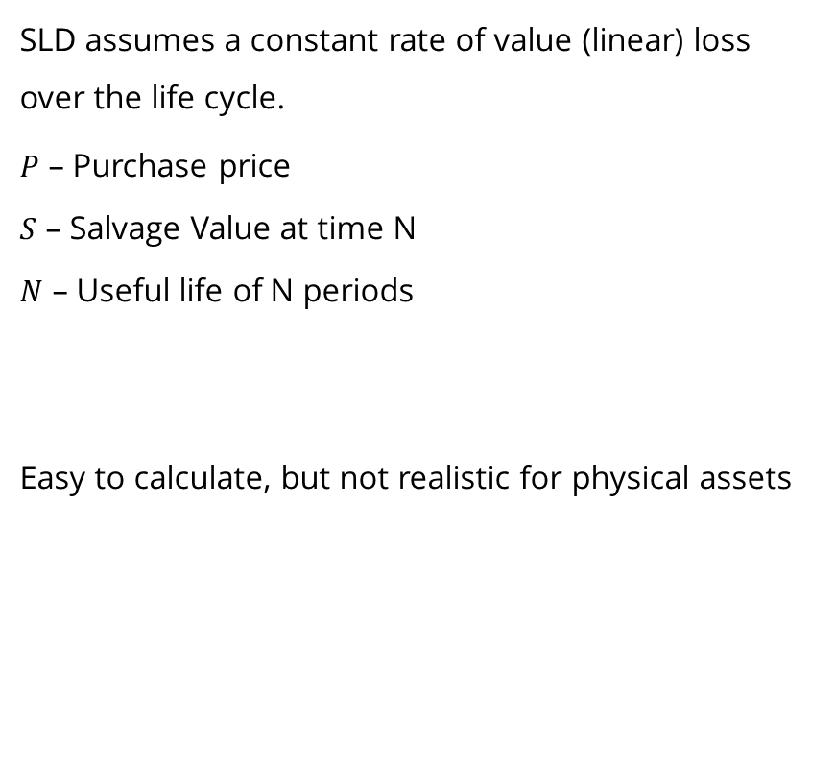
Straight-Line Depreciation
SLD assumes a constant rate of value (linear) loss over the life cycle.
$P$ – Purchase price
$S$ – Salvage Value at time N
$N$ – Useful life of N periods
Easy to calculate, but not realistic for physical assets

Slide 8
Example
An asset purchased 7 years ago for $10,000 has a service life of 10 years. It can be sold at the end of its service life for $2,000.
What is the book value today using SLD?
Notes:
BV(7) = P – n(P-S/N) = 4400

Slide 9

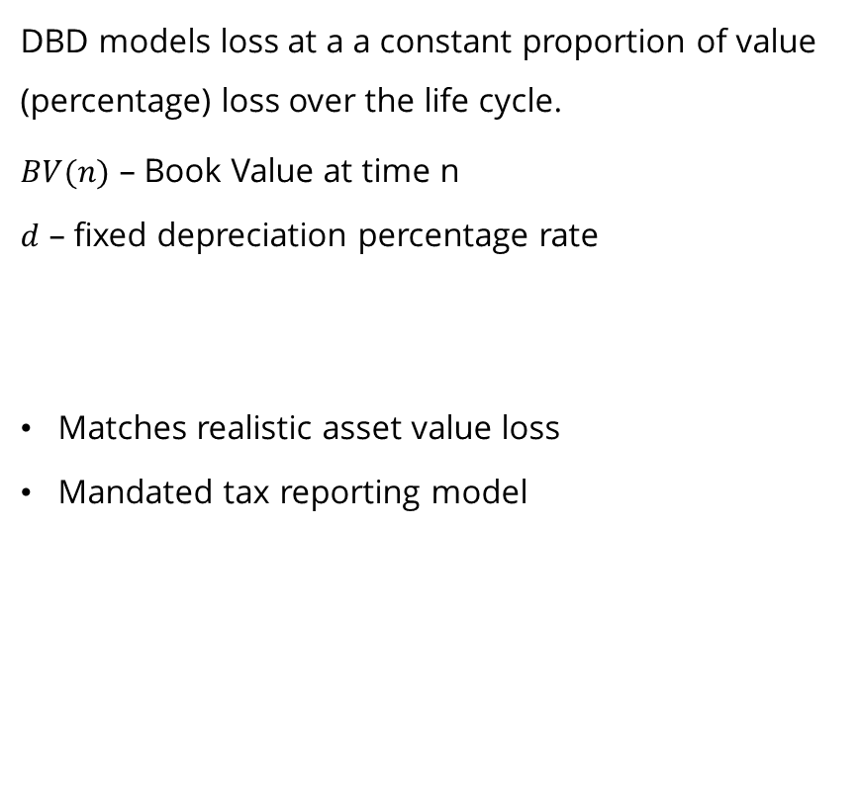
Declining Balance Depreciation
DBD models loss at a a constant proportion of value (percentage) loss over the life cycle.
$BV(n)$ – Book Value at time n
$d$ – fixed depreciation percentage rate
Matches realistic asset value loss
Mandated tax reporting model

Slide 10
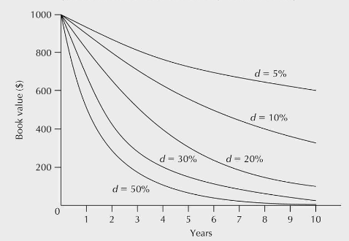

Determining DBD Percentage Rate
If the percentage rate for DBD is not specified, we need to determine the appropriate depreciation rate.
$$BV_{db}\left(N\right)=S=P{\left(1−d\right)}^{N}$$
$$d=1−\sqrt[N]{\frac{S}{P}}$$

Slide 11
Example
An asset will be purchased at a cost of $780,000. After its 20 year service life, it will have a salvage value of $60,000
What is the depreciation rate today using DBD?
Notes:
S=P(1-d)^N = 0.1204 (12.04%)

Slide 12


Slide 13
Taxes
In Canada, Federal and provincial governments levy taxes on both individuals and corporations.
Most significant form of taxation pertinent to economic analyses is income taxes. Taxes are levied on the portion of net income by an individual (income less credits) or corporation (revenue less expenses).
TAXES have SIGNIFICANT impact on the economic viability of a project.

Slide 14
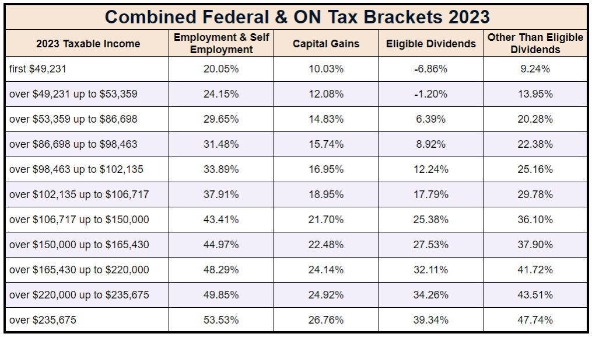
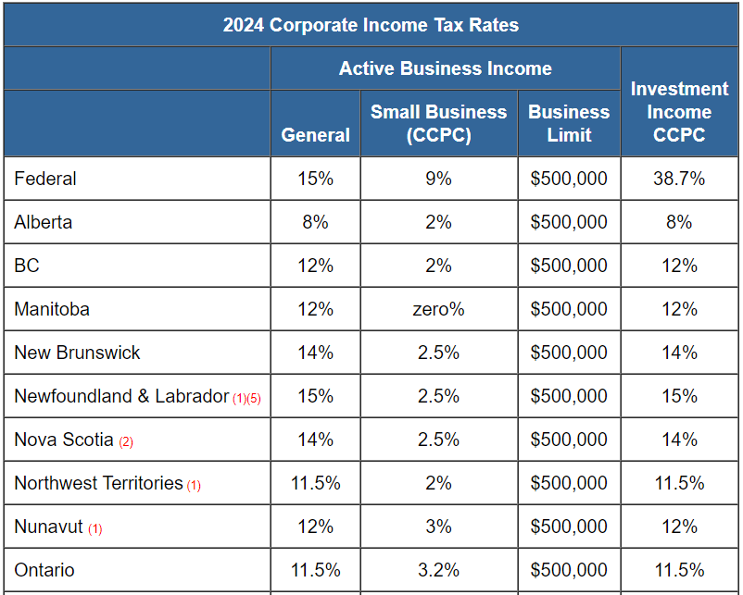
Income Taxes
Individuals
Based on income less tax credits, and is a progressive system
Corporations
Based on revenue less expenses, and is a flat-rate system based on several factors

Slide 15
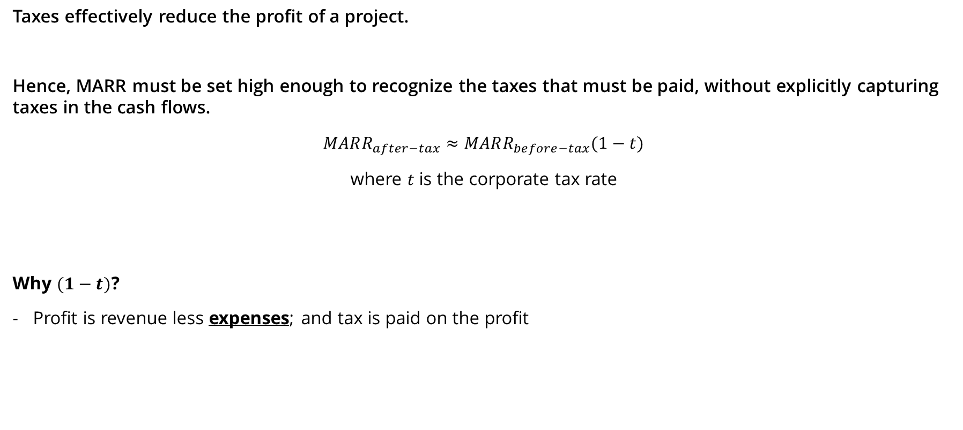
Tax Effect on MARR
Taxes effectively reduce the profit of a project.
Hence, MARR must be set high enough to recognize the taxes that must be paid, without explicitly capturing taxes in the cash flows.
$$MARR_{after−tax}≈MARR_{before−tax}(1−t)$$
where $t$ is the corporate tax rate
Why $(1−t)$?
Profit is revenue less expenses; and tax is paid on the profit
Notes:
We have been using the before-tax MARR up to this point in the course.

Slide 16

Depreciation & CCA System
Capital Cost Allowance (CCA) is the accepted tax accounting system to capture the capital expense related to depreciable assets.
Depreciation is captured as an expense.
CCA was structured to be a fair way to limit the depreciation that a corporation can expense in a given year.
Only Joking

Slide 17
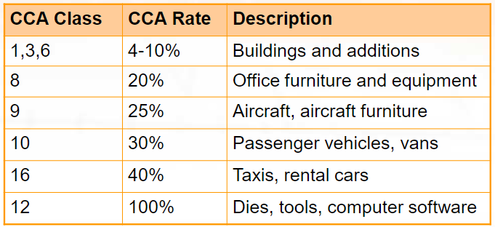
Capital Cost Allowance System
CCA system is based on a declining balance depreciation model, which specifies the maximum annual rate of depreciation (known as the CCA rate)
Assets are divided up into classes and a CCA rate assigned to each class.

Slide 18

Undepreciated Capital Cost
UCC is effectively the tax book cost for a class of assets. UCC does not represent the market value.
Define 2 UCC terms for each year:
The opening, or $UCC_{opening}$; and
The closing, or $UCC_{closing}$
The calculation for each class is simply:
$$UCC_{ending}=UCC_{opening}+purchases−dispositions−CCA$$
With a wrinkle
Notes:
Assets are pooled by class when doing CCA analysis.

Slide 19
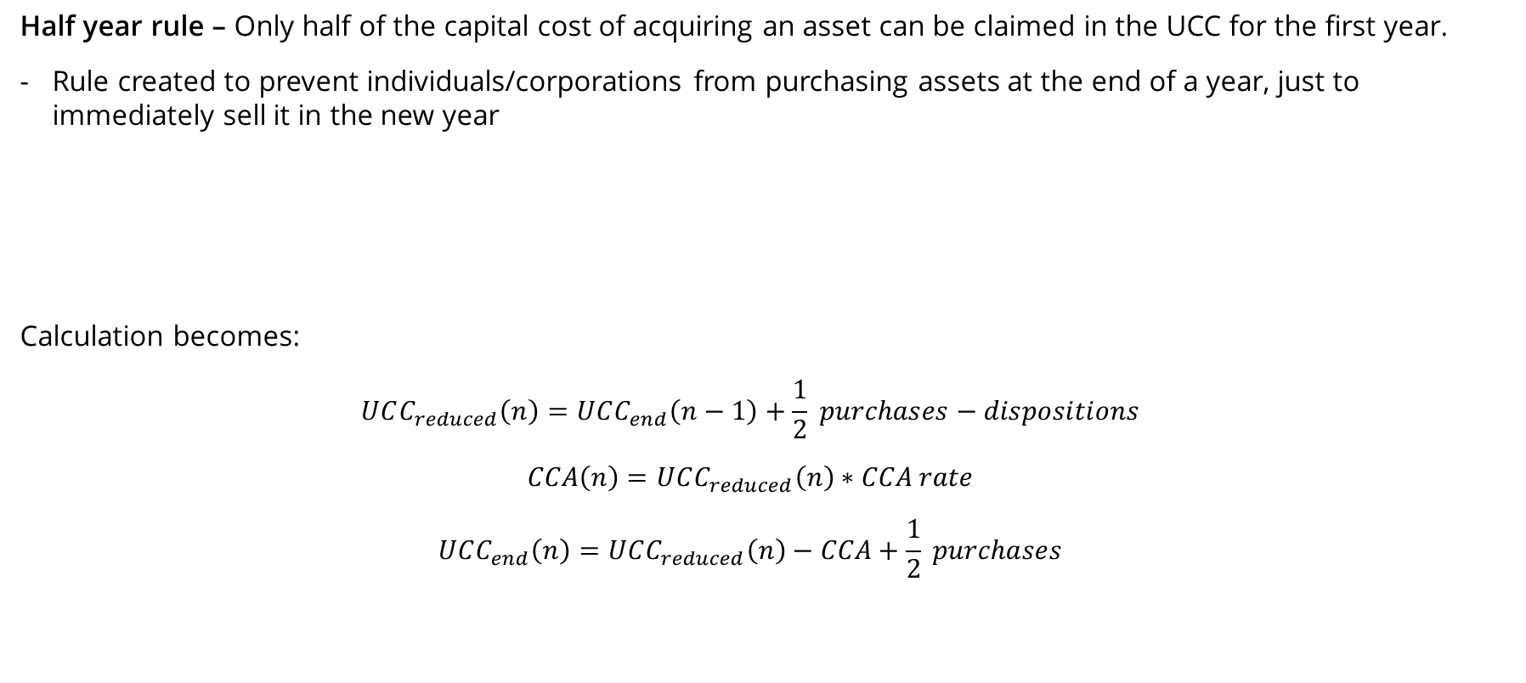
Half Year Rule
Half year rule – Only half of the capital cost of acquiring an asset can be claimed in the UCC for the first year.
Rule created to prevent individuals/corporations from purchasing assets at the end of a year, just to immediately sell it in the new year
Calculation becomes:
$$UCC_{reduced}\left(n\right)=UCC_{end}\left(n−1\right)+\frac{1}{2} purchases−dispositions$$
$$CCA\left(n\right)=UCC_{reduced}\left(n\right)∗CCA rate$$
$$UCC_{end}\left(n\right)=UCC_{reduced}\left(n\right)−CCA+\frac{1}{2} purchases$$
With even more complexities
Notes:
See T2 Schedule 8 for complexities

Slide 20
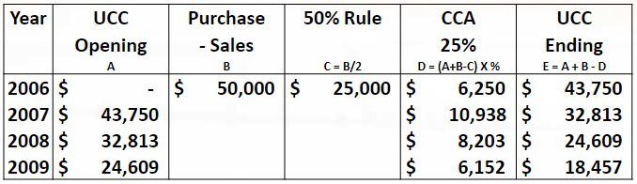
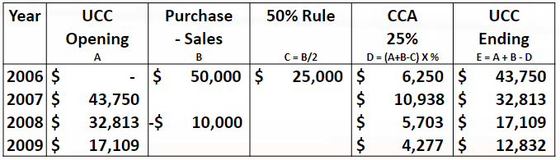
Example
Charter airline purchases 2 aircraft for $25,000 each in 2006. The CCA rate for aircraft is 25%.
What is the UCC at year-end for 2006 through 2009?
What if the airline sells an aircraft in 2008 for $10,000?

Slide 21
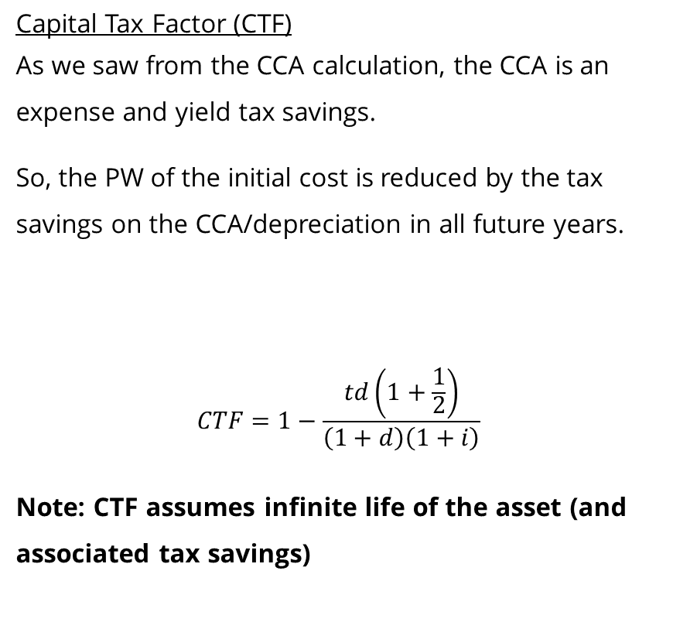
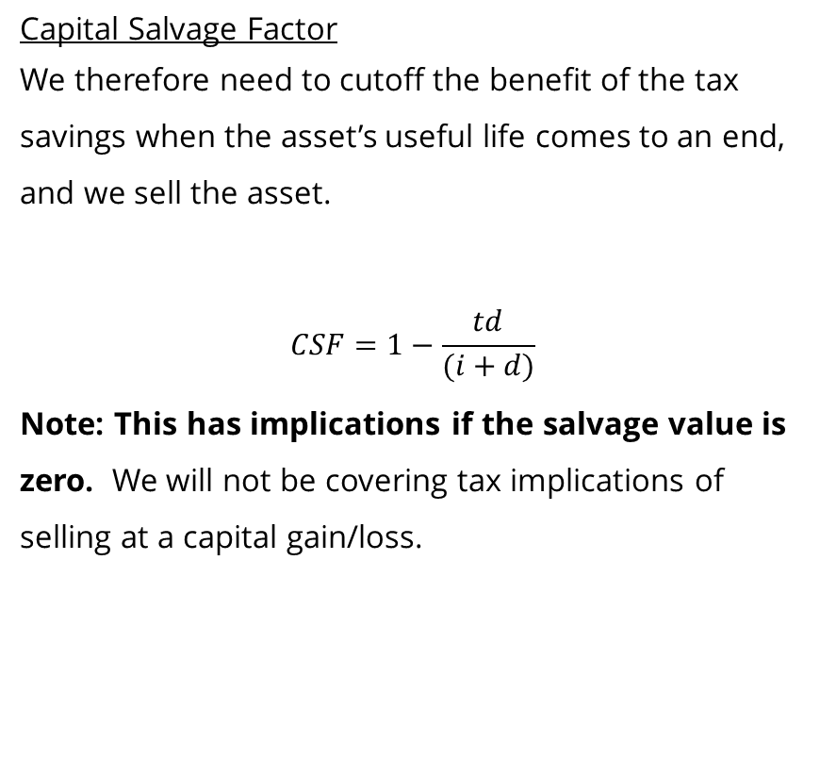
Tax Savings from CCA
Capital Tax Factor (CTF)
As we saw from the CCA calculation, the CCA is an expense and yield tax savings.
So, the PW of the initial cost is reduced by the tax savings on the CCA/depreciation in all future years.
$$CTF=1−\frac{td\left(1+\frac{1}{2}\right)}{\left(1+d\right)\left(1+i\right)}$$
Note: CTF assumes infinite life of the asset (and associated tax savings)
Capital Salvage Factor
We therefore need to cutoff the benefit of the tax savings when the asset’s useful life comes to an end, and we sell the asset.
$$CSF=1−\frac{td}{(i+d)}$$
Note: This has implications if the salvage value is zero. We will not be covering tax implications of selling at a capital gain/loss.

Slide 22
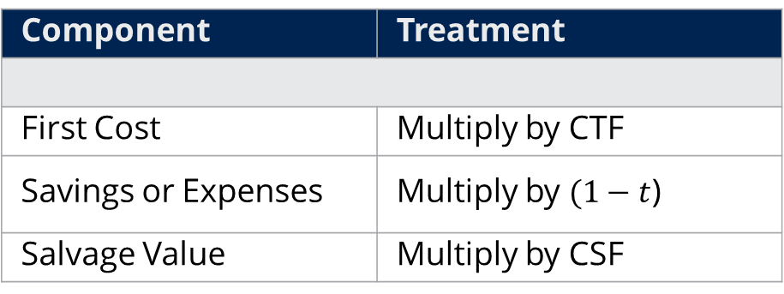
Components of a Complete Tax Calculation
Component | Treatment
First Cost | Multiply by CTF
Savings or Expenses | Multiply by $(1−t$)
Salvage Value | Multiply by CSF
Notes:
Do mathematical equivalency (interest factors) in converting to PW, FW, AW as necessary after applying tax treatment to individual cash flows.

